Slide 1
CLUSTERING TORONTO NEIGHBORHOODS BASED ON SAFETY, HOUSING PRICES, SCHOOLS & ENTERTAINMENT
by
Maryam Momodu Bassey

Slide 2
Outline
Problem description
Aim of the Project
Data Sources
Data Cleaning
Analytical Approach
Results

Slide 3
Problem Description
Canada opened its borders to skilled workers from all over the world.
People with families are among this group of emigrating skilled workers.
Finding the right neighborhood to reside is an issue for people new to a city.
Some important considerations are; housing, safety, schools for children and places of relaxation and entertainment.

Slide 4
Aim of the Project
This project aimed to use data to help guide Toronto immigrants with choosing neighborhoods to reside in with regards to safety, housing prices, availability of schools, entertainment and relaxation activities.
Creating clusters of similar neighborhoods to simplify the process of choosing a neighborhood to reside in.

Slide 5
Data Sources
Average Housing Sale prices from- https://www.zolo.ca/toronto-real-estate/neighbourhoods, 29/04/19 6.17pm
2018 Toronto crime data from- http://data.torontopolice.on.ca/datasets/98f7dde610b54b9081dfca80be453ac9_0, 28/04/19
Data for schools and entertainment centers in Toronto neighborhoods from the Four Square Location data.
Neighborhood CDN- https://en.wikipedia.org/wiki/List_of_city-designated_neighbourhoods_in_Toronto
Toronto neighborhood Geojson data https://portal0.cf.opendata.inter.sandbox-toronto.ca/dataset/neighbourhoods/
https://github.com/jasonicarter/toronto-geojson/blob/master/toronto_topo.json

Slide 6
Data Cleaning
Data downloaded and scraped were individually cleaned.
Art and Entertainment category was made up of 47 venue types while the Schools category was made up of 7 venue types.
The final dataset contained 140 Neighborhoods, their Latitude and longitude data, 3 features; Arts and Entertainment, Average Housing price in thousands and Crime rate.
The Schools feature was dropped as it did not contain much information.

Slide 7
Analytical Approach
Although DB-SCAN, K-means, Hierarchical Clustering algorithms were employed on the dataset, DB-SCAN was the algorithm of choice.
DB-SCAN's ability to locate and separate high density regions from low density regions and locating outliers was of interest.

Slide 8
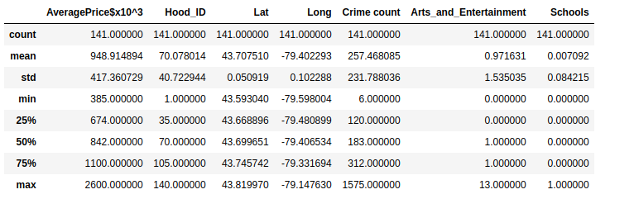
Descriptive analysis of the dataset

Slide 9
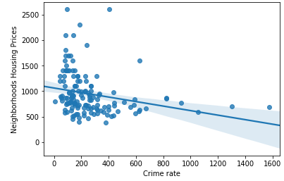
Scatter plot and regression line of Crime rate vs Housing Price
The plot above shows that the relationship between Crime rate and Housing price is non-linear.

Slide 10
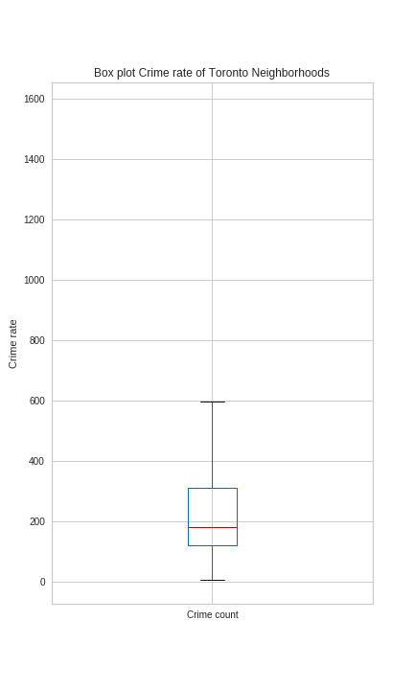
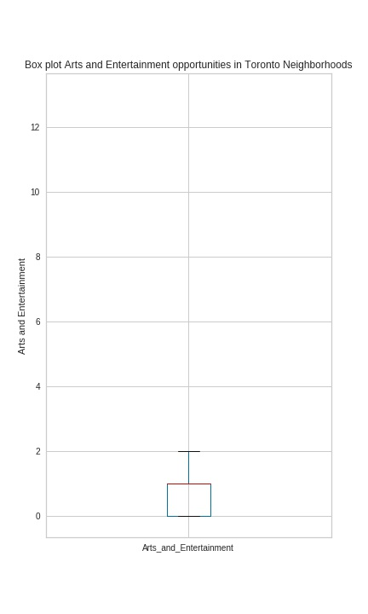
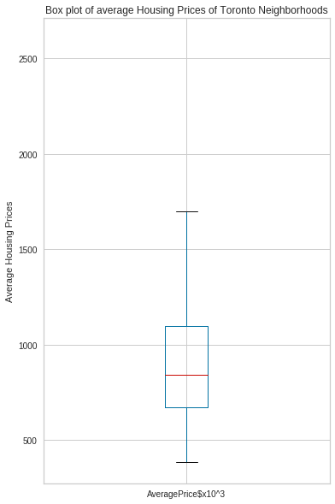
Box Plots
Box plots of data on average housing price, Crime rate and Art and entertainment opportunities was essential in creating the grading -using percentiles- for each feature and assessing outliers.

Slide 11
Creating Grades
GRADING | PERCENTILES | HOUSING PRICE($ x10^3) | CRIME RATE
LOW | Below 25 | 385 - 674 | 6- 120
AVERAGE | 25 to 50 | 675- 842 | 121- 183
ABOVE AVERAGE | 50 to 75 | 843 - 1100 | 184- 312
HIGH | 75 to maximum | 1101- 1750 | 313- 600
VERY HIGH | outliers | 1751- 2600 | 601-1575
GRADING | ARTS AND ENTERTAINMENT
NO | 0
FEW | 1- 2
FAIR NUMBER | 3- 5
LARGE NUMBER | 6- 13
* maximum is Q3 + 1.5*IQR

Slide 12
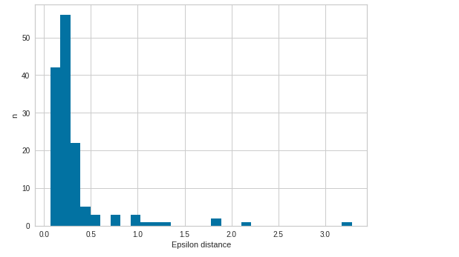
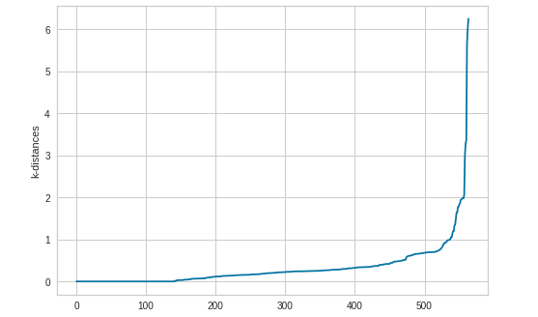
DB- SCAN- episilon determination
The minimum number of points was taken as 4, 2* dimensionality of datasets. The optimal epsilon value was calculated using Knearest neighbor distance plots and histogram.
The knee point in both figures above can be seen at 0.6, this was accepted as the epsilon value.

Slide 13
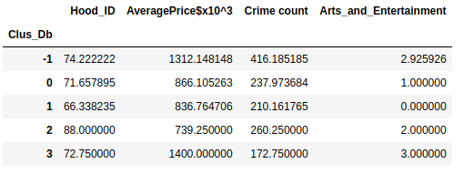
DB-SCAN- Clusters
A profile was created for each cluster, considering the characteristics of its features;
LABEL 0- Above Average Housing Price, Above Average Crime Rate, Few Entertainment Opportunities
LABEL 1- Average Housing Price, Above Average Crime Rate, No Entertainment Opportunities
LABEL 2- Average Housing Price, Above Average Crime Rate, Few Entertainment Opportunities
LABEL 3- High Housing Price, Average Crime Rate, Fair Amount of Entertainment Opportunities
LABEL -1 Outliers

Slide 14
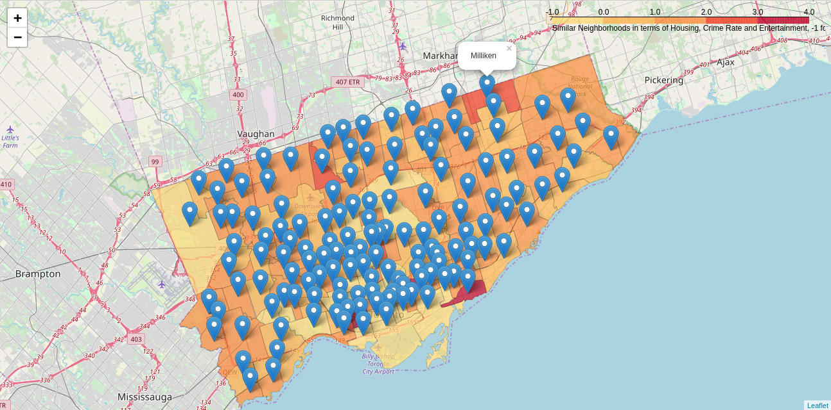
DB-SCAN- Map
This interactive map is better experienced on a browser.

Slide 15
Neighborhood Clusters
LABEL 0- Above Average Housing Price, Above Average Crime Rate, Few Entertainment Opportunities, 37 neighborhoods
LABEL 1- Average Housing Price, Above Average Crime Rate, No Entertainment Opportunities, 68 neighborhoods
LABEL 2- Average Housing Price, Above Average Crime Rate, Few Entertainment Opportunities, 4 neighborhoods
LABEL 3- High Housing Price, Average Crime Rate, Fair Amount of Entertainment Opportunities, 4 neighborhoods
LABEL -1 Outliers, 27 neighborhoods

Slide 16
Conclusion
This project provides a starting point in considering potential neighborhoods for residence and reduces the time and energy needed for such research.
Thus enabling anyone migrating to Toronto filter out neighborhoods to reside in based on their preferences.

